Slide 1


Docker
The Docker Swarm

Slide 2
Lesson Agenda
Learn to scale the container environment using swarm

Slide 3
Introduction
Docker Swarm is two main things:
An enterprise-grade secure cluster of Docker hosts
An engine for orchestrating microservices apps
Swarm groups one or more Docker nodes and lets you manage them as a cluster.
By default, we get an encrypted distributed cluster store, encrypted networks, mutual TLS, secure cluster join tokens, and a PKI that makes managing and rotating certificates a breeze. You can even non-disruptively add and remove nodes.
Swarm exposes a rich API that allows you to deploy and manage complex microservices apps with ease. You can define your apps in declarative manifest files and deploy them to the Swarm with native Docker commands. You can even perform rolling updates, rollbacks, and scaling operations. Again, all with simple commands.

Slide 4
Swarm
On the clustering front, a swarm consists of one or more Docker nodes. These can be physical servers, VMs, Raspberry Pi’s, or cloud instances. The only requirement is that all nodes have Docker installed and can communicate over reliable networks.
Nodes are configured as managers or workers. Managers look after things like the state of the cluster and dispatching tasks to workers. Workers accept tasks from managers and execute them.
The configuration and state of the swarm is held in a distributed etcd database located on all managers. It’s kept in memory and is extremely up-to-date. But the best thing about it is that it requires zero configuration — it’s installed as part of the swarm and just takes care of itself.

Slide 5
Running, docker swarm init, on a Docker host in single-engine mode will switch that node into swarm mode, create a new swarm, and make the node the first manager of the swarm.
Additional nodes can then be joined to the swarm as workers and managers. Joining a Docker host to an existing swarm switches them into swarm mode as part of the operation.
Swarm managers have native support for high availability (HA). This means one or more can fail, and the survivors will keep the swarm running.
Technically speaking, swarm implements a form of active-passive multi-manager HA. This means that although you have multiple managers, only one of them is active at any given moment. This active manager is called the “leader”, and the leader is the only one that will ever issue live commands against the swarm.

Slide 6
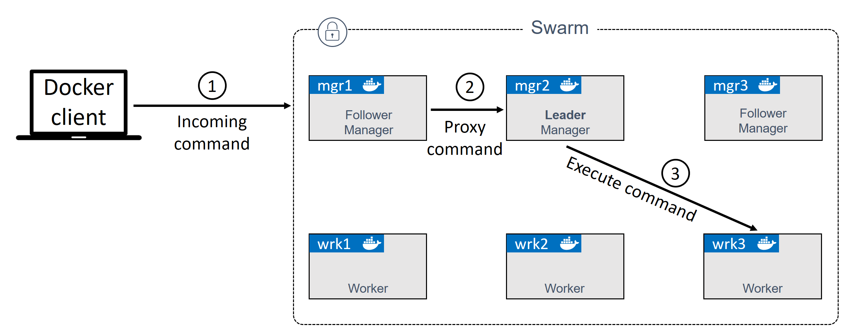
If a follower manager (passive) receives commands for the swarm, it proxies them across to the leader. managers are either leaders or followers.

Slide 7
Docker allows you to lock a swarm with the Autolock feature. This forces restarted managers to present the cluster unlock key before being admitted back into the cluster.
services are a new construct introduced with Docker 1.12, and they only apply to swarm mode.
Services let us specify most of the familiar container options, such as name, port mappings, attaching to networks, and images. But they add important cloud-native features, including desired state and automatic reconciliation.
You can create services in one of two ways:
Imperatively on the command line with docker service create
Declaratively with a stack file

Slide 8
The default replication mode of a service is replicated. This deploys a desired number of replicas and distributes them as evenly as possible across the cluster
The other mode is global, which runs a single replica on every node in the swarm.
To deploy a global service you need to pass the --mode global flag to the docker service create command.

